Slide 1
HW3 Framework

Slide 2
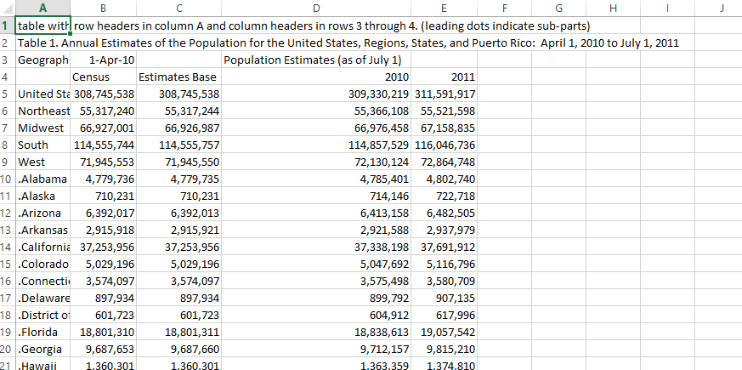
http://www2.census.gov/programs-surveys/popest/tables/2010-2011/state/totals/nst-est2011-01.csv

Slide 3
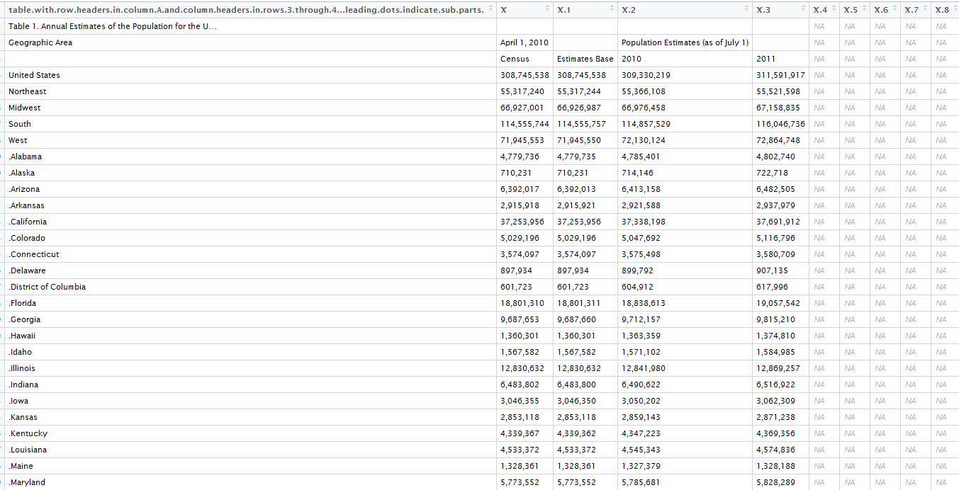
After you read it into R
66 obs 10 var

Slide 4
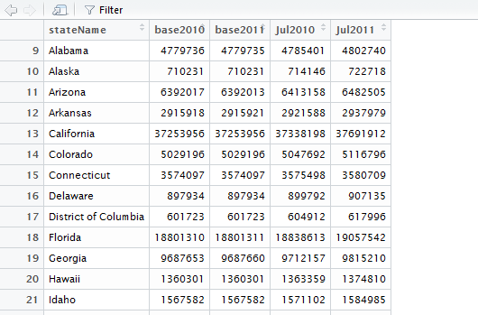
After cleansing
51 obs 5 var

Slide 5
Approach – Steps 1 & 2
1st – determine logic
Read data set
Cleanse
Remove rows
Assign col headings
Cleanse content
2nd – try formula’s
Via console
note which variables will be input via function
3rd - validate output
4th – develop function
Based on your results in 2nd step above build function in chunks or if you are relatively comfortable build the entire function

Slide 6
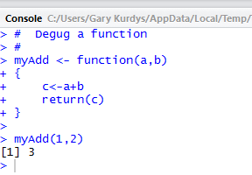
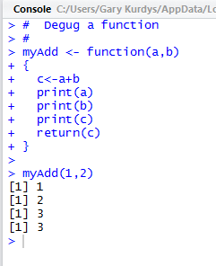
Function Debugging
Use print statements

Slide 7
Step 5
Question 13
What is or where is dfStates$Jul2011Num
Question 13 answer if your function is correct
.66

